Slide 1
AWS Honolulu User Group
2018-02-08 - 1st Meetup

Slide 2
Agenda
AWS Honolulu User Group
Cloud Computing
AWS
Setting up a billing alarm
Creating your first app with AWS CodeStar

Slide 3
What is AWS Honolulu User Group?
Our Intent Our intent is to spread the voice out, educate, create working sessions, share our expertise, and, of course, have a good time and share some beers and pizza! Our Mission Our Mission is to, as a group, create a space where anyone in the state of Hawaii can find answers and guidance on how to leverage the world's largest public cloud provider (AWS).

Slide 4
Introductions…
What’s your name?
What is your background? What do you do?
Have you used AWS (or other cloud provider) before?
What do you expect from this meetup?
Notes:
Hand raised
How many of you have an AWS account?
How many of you have a billing alarm setup in your account?

Slide 5
Why Cloud Computing?
“10% of the internet runs in the cloud...we are yet to migrate the 90%! We need people with cloud experience”
Re:Invent 2017
“It's predicted that more than 50% of software workloads will move to the cloud by 2020”
Re:Invent 2017

Slide 6
Cloud Computing benefits
Pay as you go
Scale up and out
Economy of scale discounts
Access to innovation and bleeding edge technologies
Etc, etc, etc

Slide 7
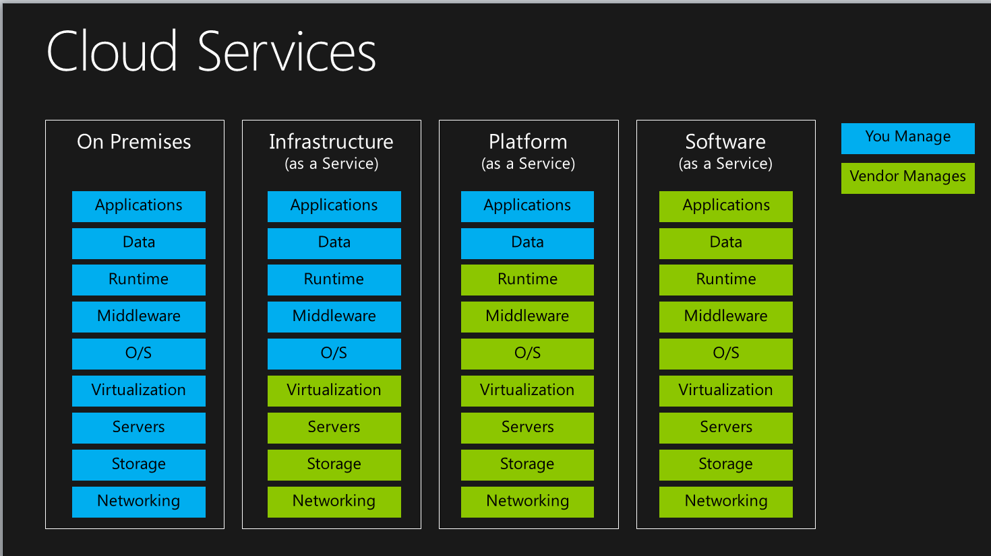
*aaS (IaaS, PaaS, SaaS, FaaS, etc.)
+ CaaS
+ FaaS

Slide 8

Why AWS? Cloud Providers Evolution
source: A Cloud Guru Youtube Channel - https://www.youtube.com/watch?v=0fE2Dxl1BOc

Slide 9
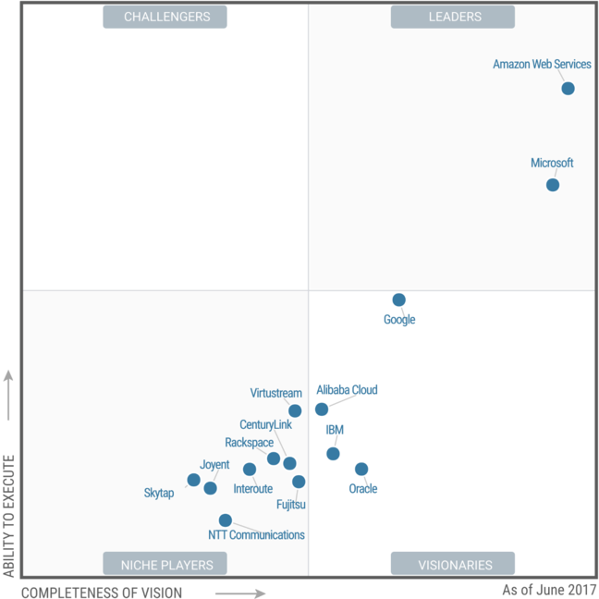
Why AWS? Gartner Magic Quadrant 2017

Slide 10
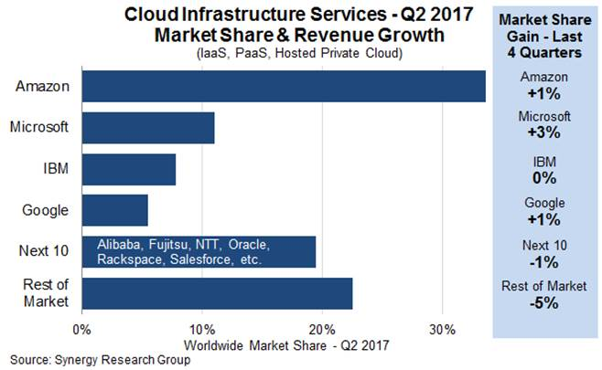
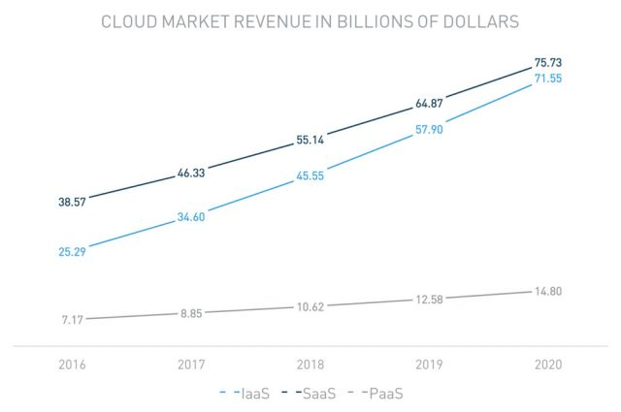
Why AWS? Cloud Market Share

Slide 11
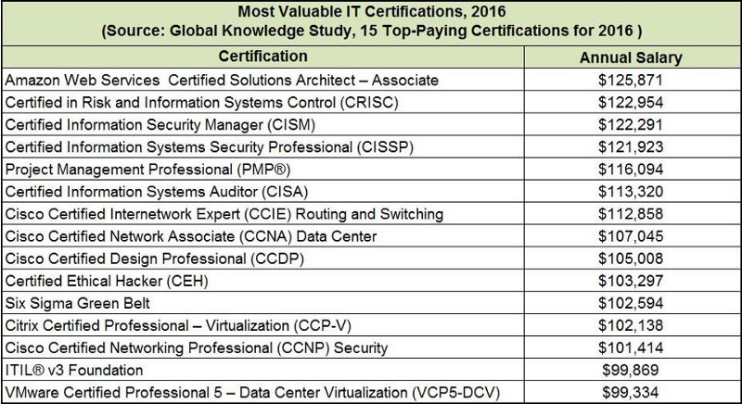
Why should you learn AWS?
“10% of the internet runs in the cloud...we are yet to migrate the 90%! We need people with cloud experience”
Re:Invent 2017
“A certificate in Amazon's AWS cloud technology can boost your salary by 26%”
Business Insider

Slide 12
What is AWS?
For 11 years, AWS has been the world’s leader cloud provider, hitting a market share of almost 50%.
AWS provides a plethora of different services that can add value to, almost, any business field (Virtual Machines, High Availability, Disaster Recovery, Serverless Computing, DBs, Notifications, Mobile Development tools, Internet of Things, Machine Learning, Big Data, Transcoding, etc, etc, etc).

Slide 13
AWS History
2003 – Paper and business model for selling Amazon infra as a service
2004 – SQS
2006 – AWS Officially launched
2010 – All Amazon.com moved to AWS
2012 – First Re:Invent
2013 – Certifications
2015 – AWS breaks out its revenue

Slide 14
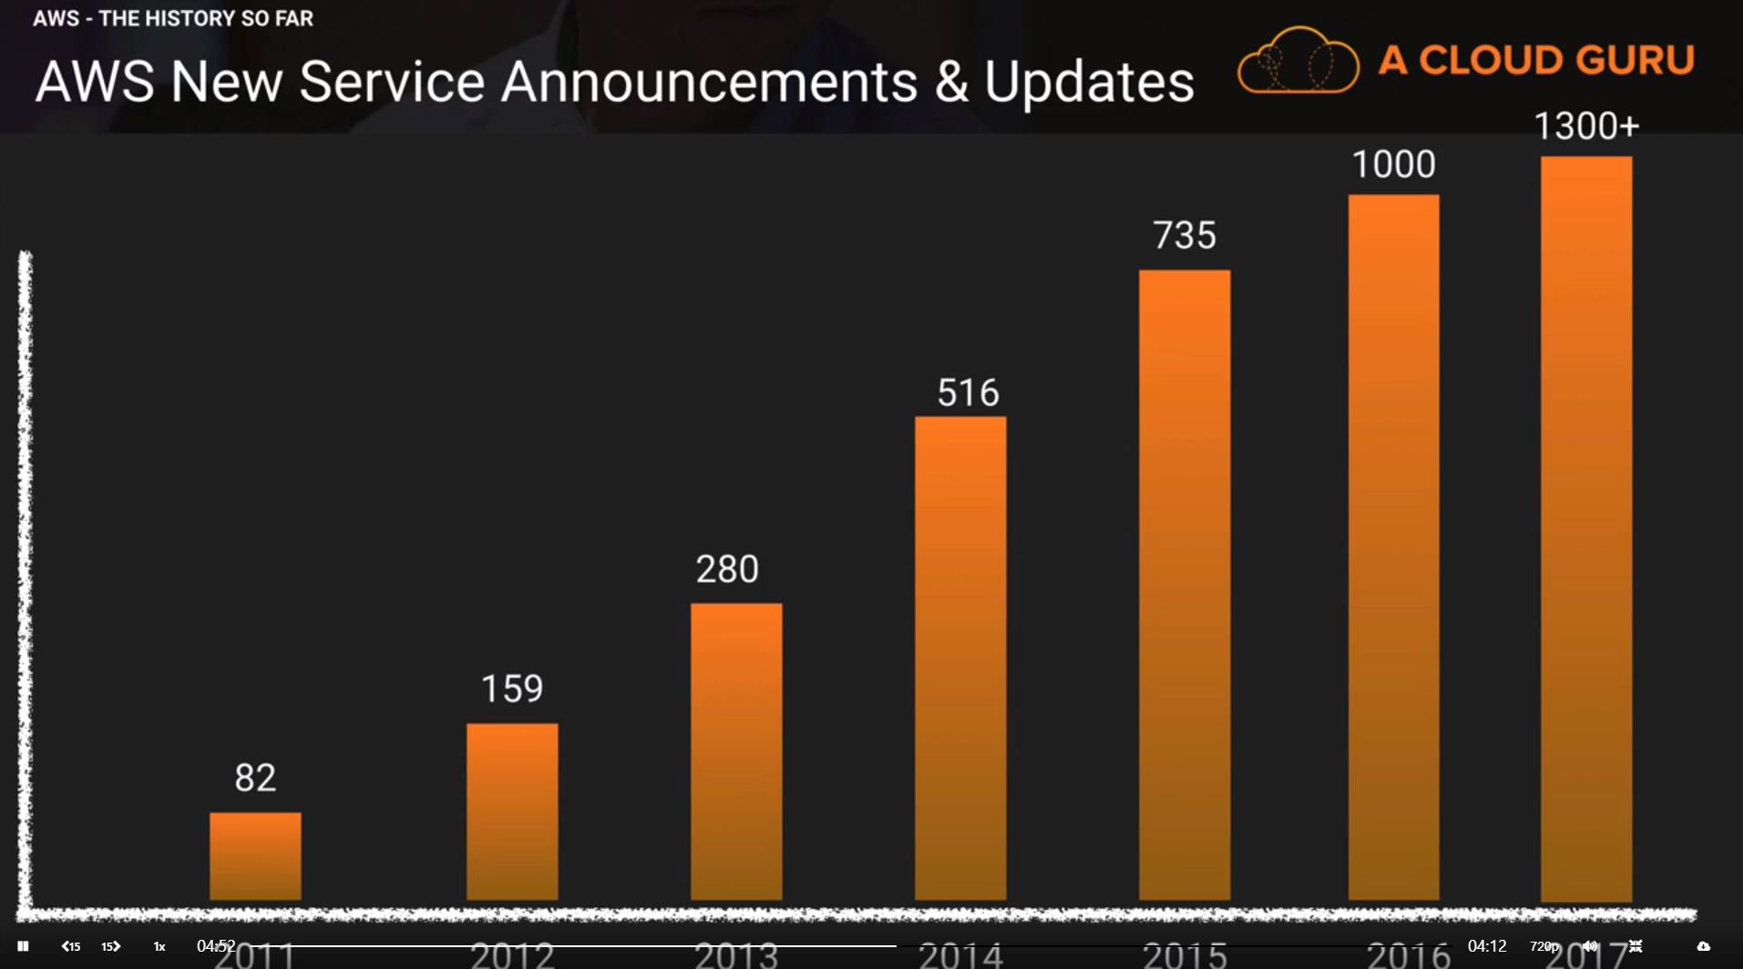
AWS Innovation pace

Slide 15
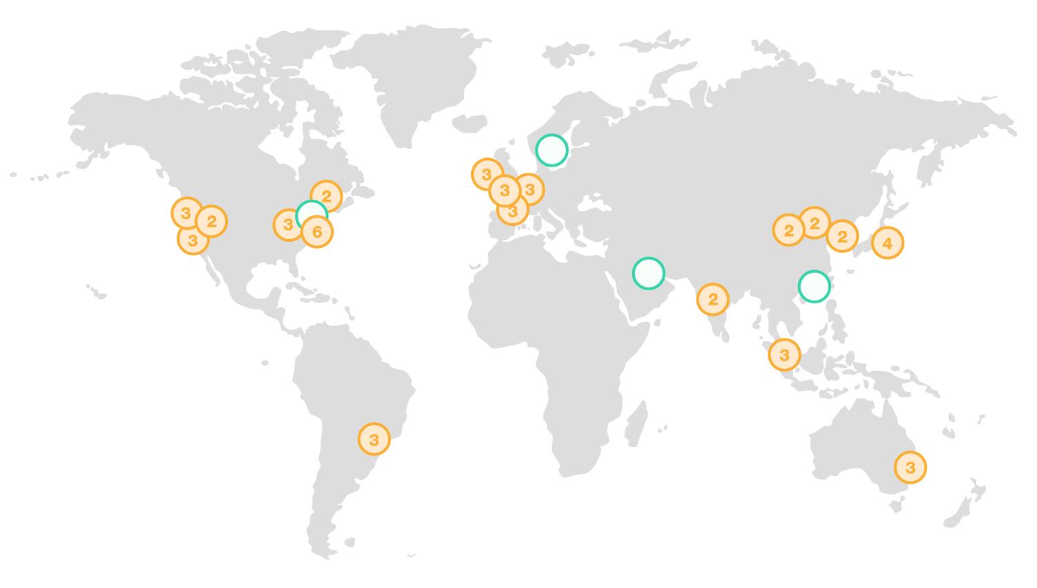
AWS Global Infrastructure
18 Regions (+4 in 2018)
52 Availability Zones (+12 in 2018)
100+ Edge Locations (CDN)

Slide 16
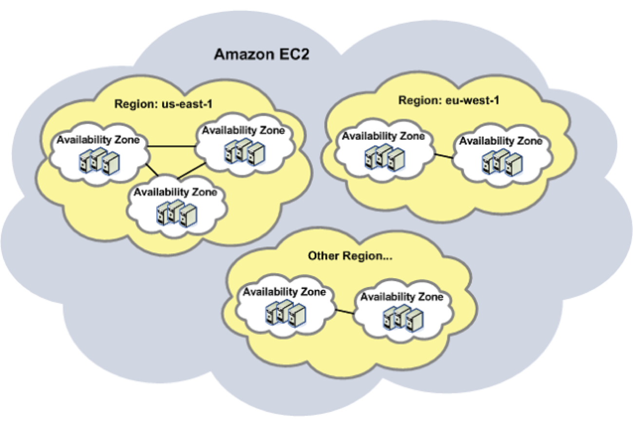
Regions and Availability Zones
Region: Geographical area consisting of 2+ AZs
AZ: Datacenter far enough apart from each other to survive natural disasters. Still with low latency

Slide 17



AWS’s Backbone
Simple Storage Service
Object storage built to store and retrieve any amount of data from anywhere and designed to deliver 99.999999999% (eleven 9s) durability. Widely used across all different AWS services, specially for input/output of files. It also lets you host static websites (angular/react/vue.js) or content.
S3
Elastic Compute Cloud
Provides secure, resizable compute capacity in the cloud. AKA VMs in the cloud. Widely used across many different AWS services for processing and computing.
EC2
Virtual Private Cloud
Lets you launch AWS resources in a virtual network that you define. You have complete control over your virtual networking environment, including selection of your own IP address range, creation of subnets, and configuration of route tables and network gateways.
VPC

Slide 18
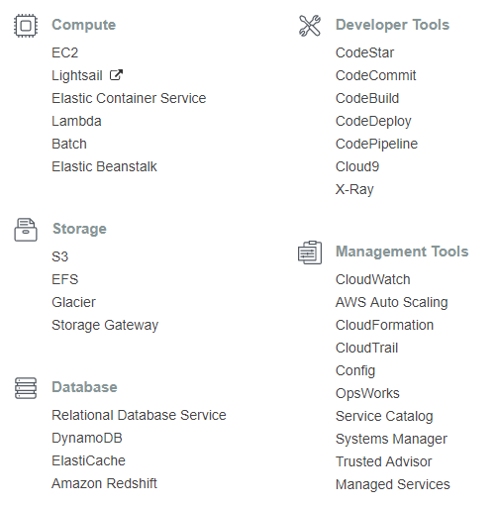
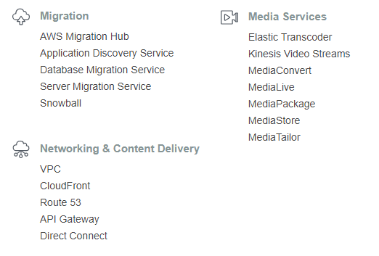
AWS Services

Slide 19
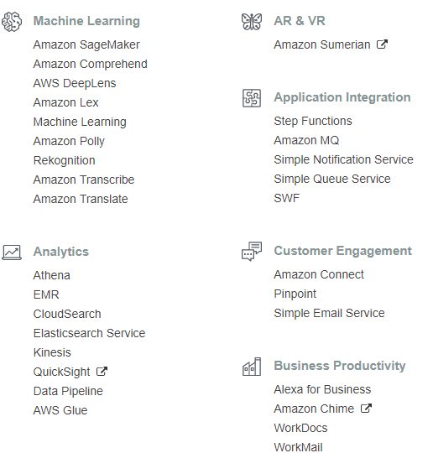
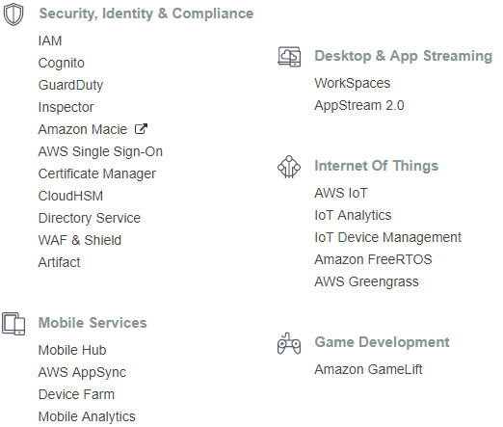
AWS Services

Slide 20
How to use AWS?
Web Console
AWS CLI
AWS API
SDKs (python, nodejs, js, .net, java, php, etc.)

Slide 21



Free Tier
12 MONTHS
ALWAYS
5GB of Storage
25GB of NoSQL storage
S3
DynamoDB
1 million requests
3.2 million execution seconds
750hs x month of t2.micro instance
30GB SSD drive
EC2
Lambda
750hs x month of t2.micro database
And much, much, much more
aws.amazon.com/free
RDS

Slide 22
Resources
AWS in Plain English
A Cloud Guru
Cloud Academy
Linux Academy

Slide 23
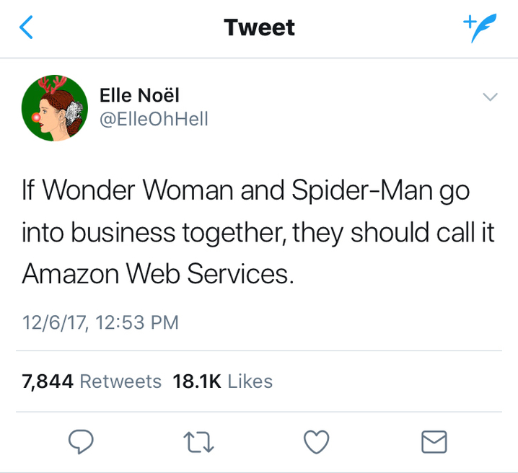
Questions?

